Slide 1
Exception Handling

Slide 2
Contents
What is exception?
Exception handling in C#
Keywords for Exception Handling
Exception Classes

Slide 3
What is an Exception in C#?
Exception
problem that arises during the execution of a program.
C# exception
response to an exceptional circumstance
arises while a program is running,
such as an attempt to divide by zero.
provide a way to transfer control
Notes:
Exceptions provide a way to transfer control from one part of a program to another.

Slide 4
Exception handling in C#?
a structured solution in the form of try and catch blocks.
core program statements are separated from the error-handling statements.
prevent crashing of program.

Slide 5
Keywords for exception handling
Exception handling is implemented using keywords
Try
block identifies a block of code for which particular exceptions is activated.
Catch
catch keyword indicates the catching of an exception.
Finally
used to execute a given set of statements
Throw
throws an exception when a problem shows up

Slide 6
Try-catch keyword
Exceptions are handled using try/catch keywords together
Syntax:
try {
// code that may raise exceptions
}
catch(Exception ex) {
// handle exception
}

Slide 7
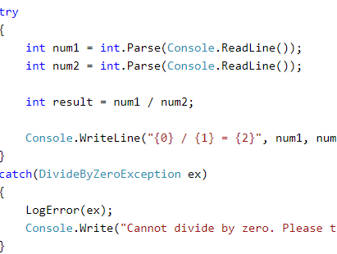
Example

Slide 8
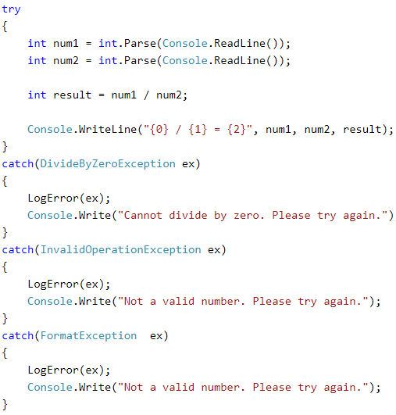
Multiple catch blocks
Single try block can have multiple catch blocks
Catch blocks should be different

Slide 9
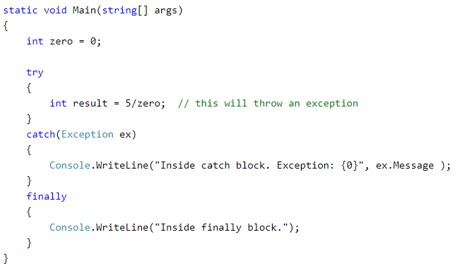
Finally keyword
The finally block is used to execute a given set of statements,
whether an exception is thrown or not thrown.

Slide 10
Example Code
Public Student{
Public string StudentName;
Public printStudentName(){
Console. WriteLine(“Student name is {0}:”,StudentName);
}
}

Slide 11
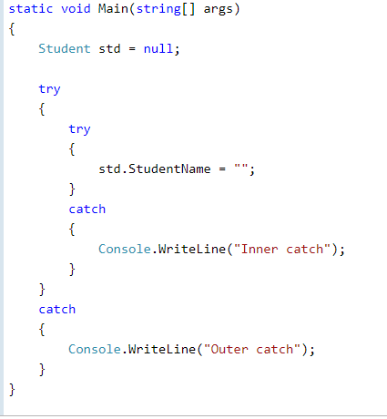
Nested Try-Catch

Slide 12
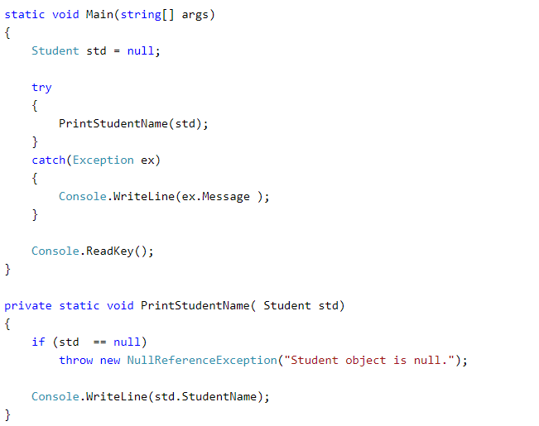
Throw keyword
exception can be raised manually using throw keyword.
exceptions derived from Exception class can be raised using the throw keyword

Slide 13
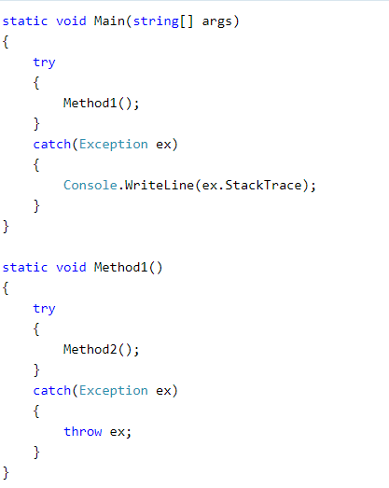
Re-Throwing Exception
Can throw an exception from catch block
to pass on to the caller
let the caller handle it the way they want.

Slide 14
Exception Classes
C# exceptions represented by classes
directly or indirectly derived from the System.Exception class
Main classes derived from system. Exception class are
System.ApplicationException
System.SystemException

Slide 15
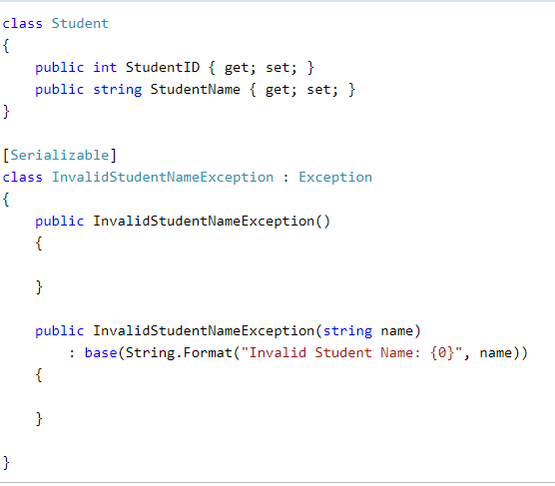
System.ApplicationException
supports exceptions generated by application programs
the exceptions defined by the programmers should derive from this class.

Slide 16
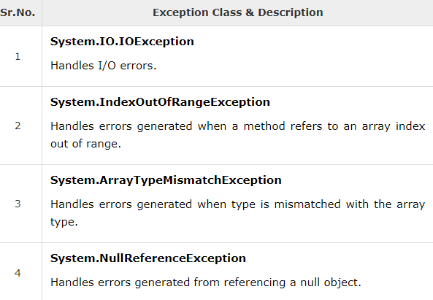
System.SystemException
base class for all predefined system exception.
Some System.SystemException’s classes are:

Slide 17
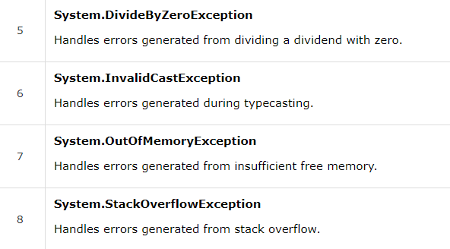
System.SytemException

Slide 18
Any Questions???

Slide 19

This Photo by Unknown Author is licensed under CC BY

